Slide 1
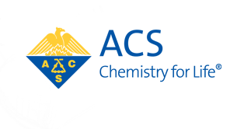
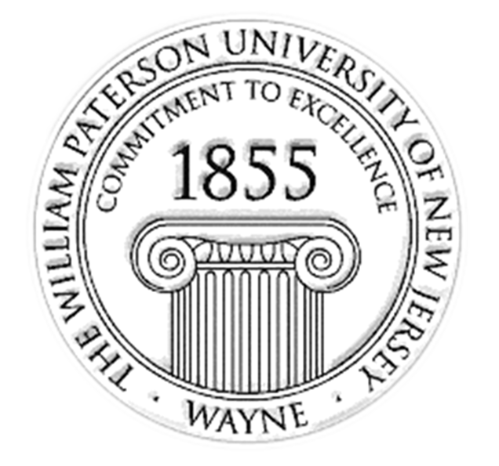


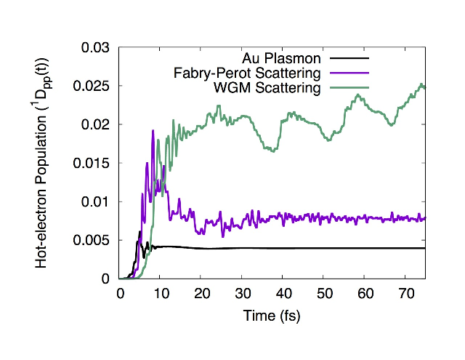
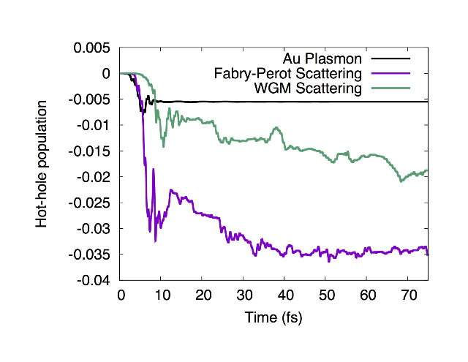
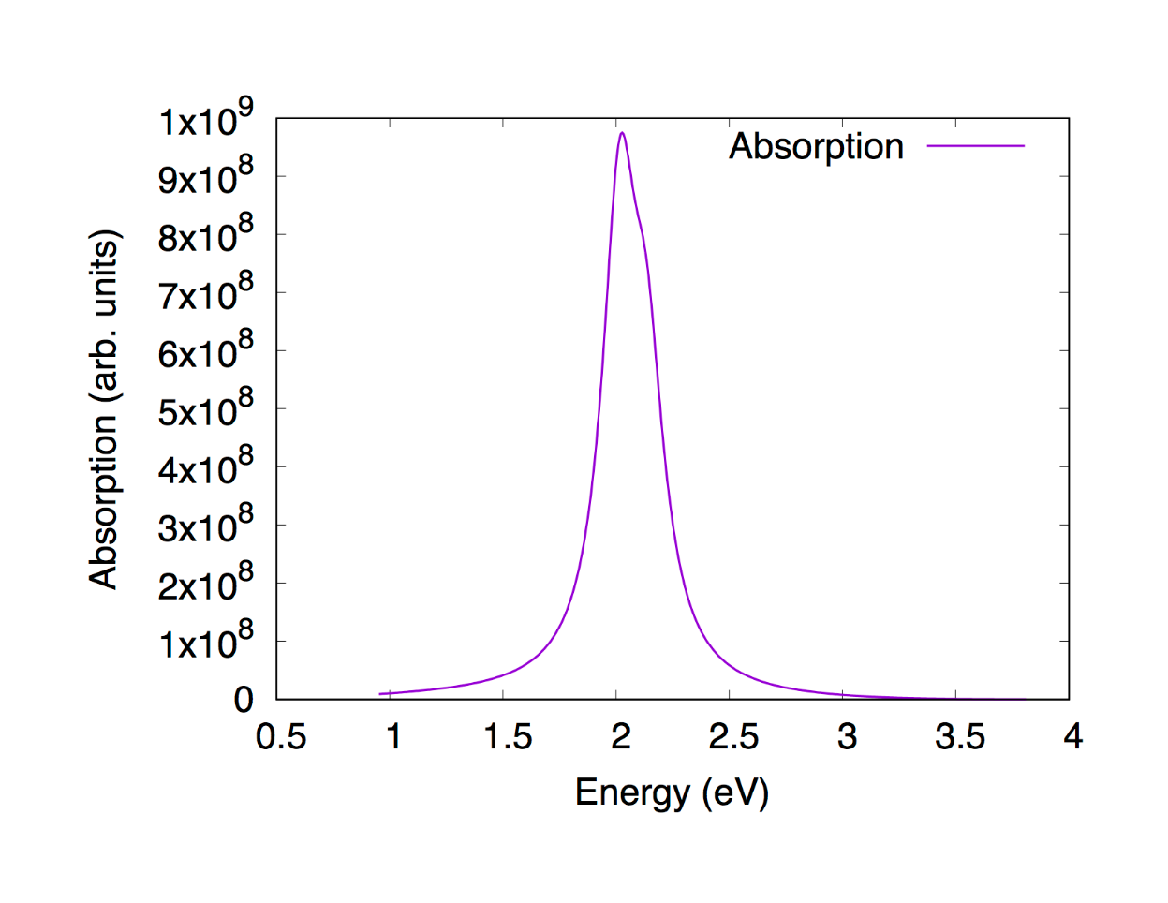
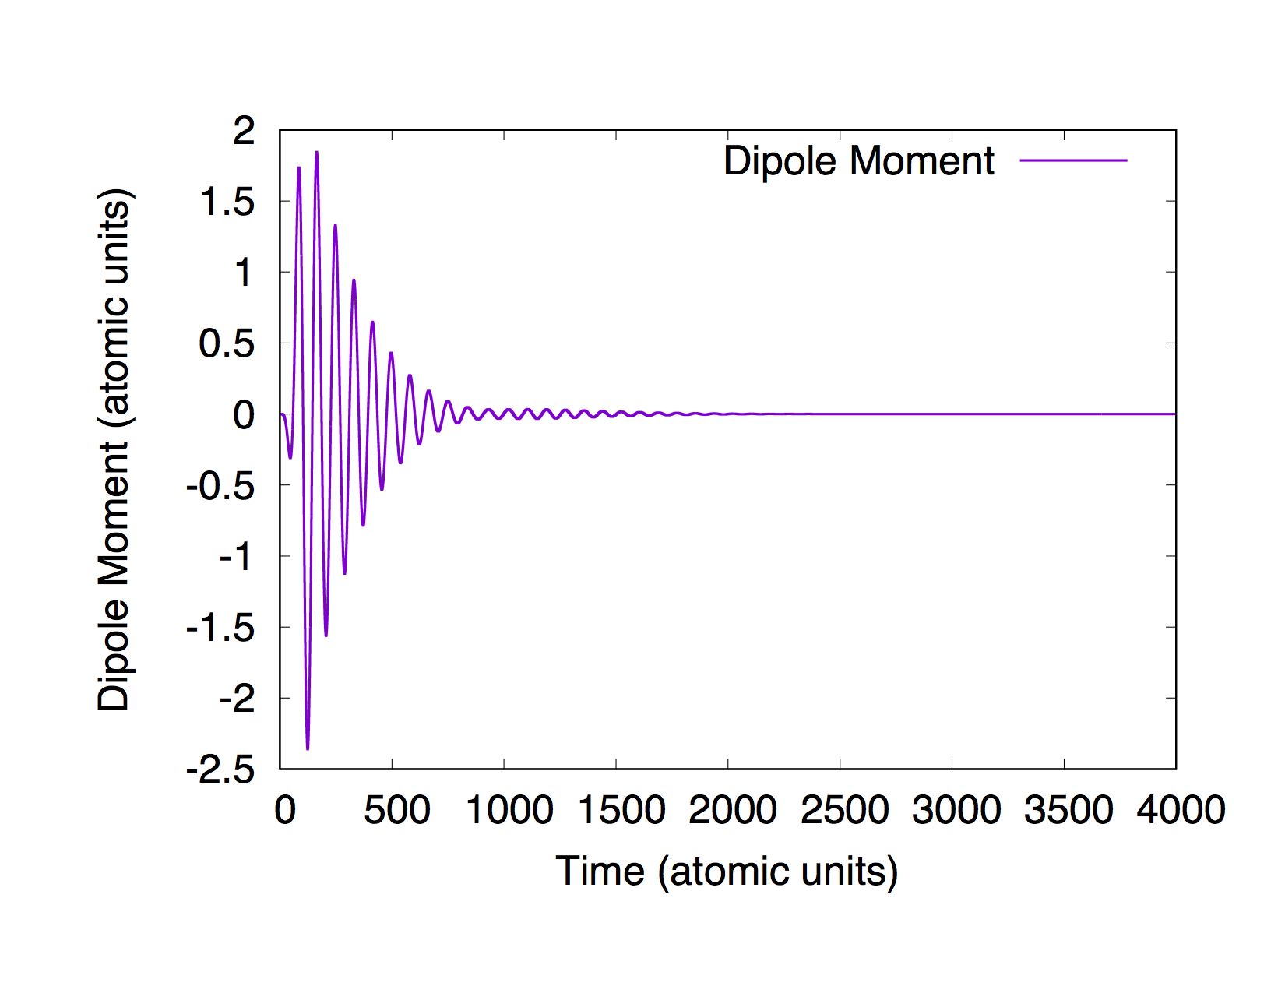
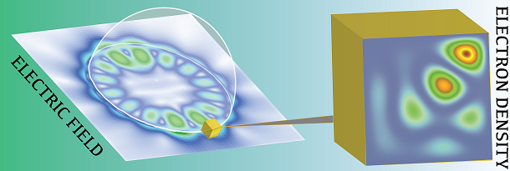
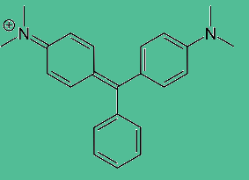
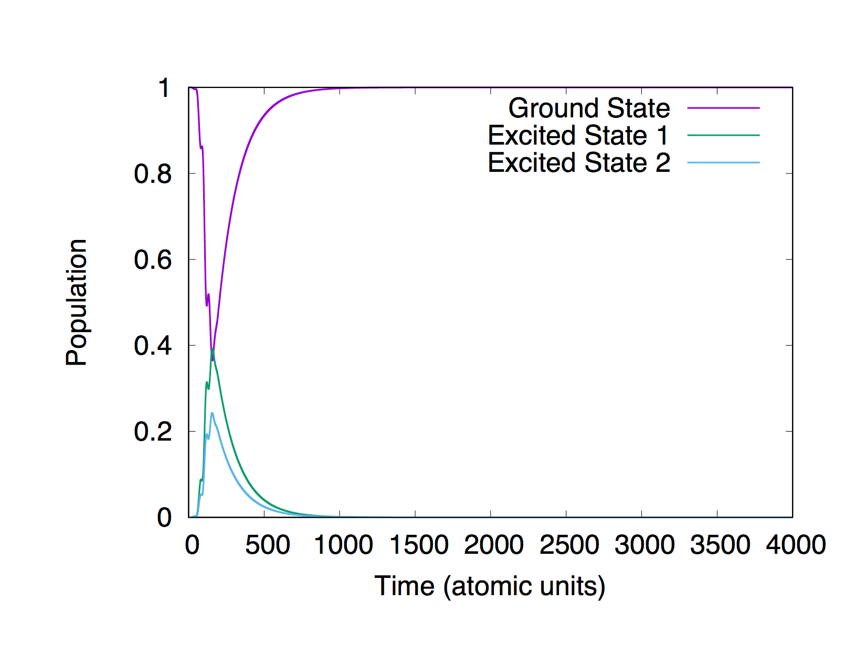
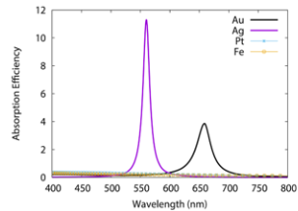
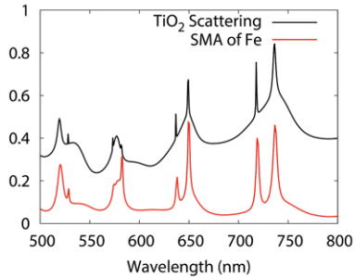

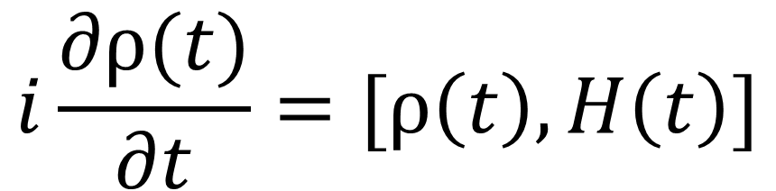
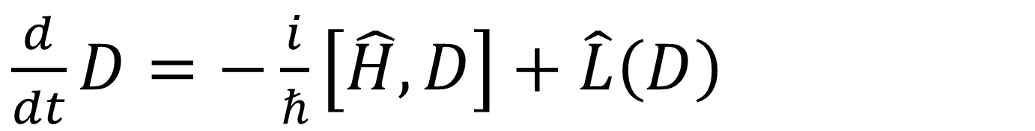
Unique Hot Carrier Distributions From Scattering Mediated Absorption
Matthew Micek and Dr. Jonathan Foley
Department of Chemistry, William Paterson University
Abstract
Results of Au
Methods
“Scattering mediated absorption” (SMA) is a phenomenon that utilizes the strong scattering of light by dielectric nanoparticles, coupled with the broad absorption of this scattered light by the metals.
We have observed SMA in hierarchical nanoparticles that consist of large dielectric nanospheres decorated with small metal nanoparticles ( Fig 1)
By comparing the generation of hot electrons from Scattering Mediated Absorption (SMA) as opposed to Local Surfaced Plasmon Resonance (LSPR), we found out that SMA can produce hot carriers with substantial efficiency.
This phenomena can then be utilized to transfer energy generated by the hybrid nanocrystal in order to transfer to a coupled molecule, in this case the dye malachite green, via the nanocube leading to scattering mediated energy transfer (SMET), which can be used in many applications such as: catalysis in a chemical reaction, solar chemistry, as well as medical applications.
We study the phenomenon known as the “Scattering Mediated Energy Transfer”, which utilizes the strong scattering of light absorbed by the dielectric sphere, coupled with the strong absorption from the metal nanoparticles which generates hot electrons/hot holes which can be coupled with another molecule to induce the energy transfer.
Our goal is to couple the hybrid nanostructure with malachite green in order to measure the amount of energy that can be transfer via scattering mediated energy transfer.
Liouville Equation With Lindblad Operator:
$\frac{d}{dt}D=−\frac{i}{ℏ}\left[\hat{H},D\right]+\hat{L}\left(D\right)$
The Liouville equation was utilized to solve for a density matrix (D) as it changes over time from the electron interactions. The energy of the system will change over time based on the dissipation term associated with the Lindblad Operator which acts on the density matrix. Once the vales for the density matrix are computed, the density matrix will be multiplied by a Hamiltonian matrix which will give a final density matrix that changes with time.
Fig, ) Displays the scattering mediated absorption by the dielectric core.
Fig. ) Shows the change in occupation of highest orbital in the active space above the Fermi level (hot electrons)
Fig. ) Shows the change in occupation of lowest orbital in the active space below the Fermi level (hot holes)
Maxwell’s Equation
Introduction
Results of Malachite Green
$$μ₀×\frac{∂}{∂t}H\left(r,t\right)=−∇×E\left(r,t\right)$$
N-Level System With Dephasing
$$i\frac{∂ρ(t)}{∂t}=[ρ\left(t\right),H\left(t\right)]$$
Maxwell’s equation is used to find the scattering cross sections of arbitrary objects since it allows the simulation of the total-field region to contain only scattered fields. This allows for an arbitrary of quantum molecules to be treated using any quantum method.
Fig.1)
Fig.2)
Conclusion
Fig. 1) Above shows the dielectric core and how it scatters light; the electron density of metal nanocube can be strongly perturbed when placed in the vicinity of the scattered electric field.
Fig. 2) Structure of the dye malachite green
Scattering mediated absorption enables the hierarchical nanoparticles to produce hot electrons/hot hole generation with greater efficiency.
Scattering mediated energy transfer is most likely to have future development with applications such as solar energy conversion, as well as photocatalysis.
Fig. ) Intensity of the induced dipole of malachite green after being exposed to a laser pulse.
Fig. ) Simulated absorption spectrum of malachite green after being Fourier Transformed.
Fig.3)
Acknowledgements
This work was funded by the College of Science and Health, Center for Research and the Department of Energy (Contract Number: DE-AC02-06CH11357).
References
Fig. 3) Absorption spectrum of various plasmonic and non plasmonic metals.
Fig. 4) Scattering spectrum of a large dielectric nanosphere and the corresponding SMA spectrum of this nanosphere decorated with iron nanoparticles.
Unique Hot Carrier Distributions from Scattering
Mediated Absorption
Kimberly Fernando, Jason Codrington, Noor Eldabagh,
and Jonathan J. Foley, IV
ACS Photonics 2017 4 (3), 552-559
DOI: 10.1021/acsphotonics.6b00773
Near-field dielectric scattering promotes optical absorption by platinum nanoparticles
Nan Zhang^{1,2}, Chuang Han^{1,2}, Yi-Jun Xu^{1,2}*, Jonathan J. Foley IV^{3,4}, Dongtang Zhang⁵, Jason Codrington³, Stephen K. Gray⁴ and Yugang Sun⁵ *
Nature Photonics 2016 10, 473-482 DOI:10.1038/nphoton.2016.76
Enhanced optical absorption in semiconductor nano-
particles enabled by nearfield dielectric scattering
Kowsalya D. Rasamani¹, Jonathan J. Foley IV², Brittney Beidelman^{1,3,} and Yugang Sun¹
Nano Research Paper 2016
DOI 10.1007/s12274-016-1406-1
Functional Subsystems and Quantum Redundancy in Photosynthetic Light Harvesting
Nolan Skochdopole and David A. Mazziotti*
J. Phys. Chem. Lett., 2011, 2 (23), pp 2989–2993
DOI: 10.1021/jz201154t
Hypothesis
Fig. ) Energy populations of malachite green.
The hierarchical nanoparticle has the emergent property of scattering mediated energy transfer which can be coupled with a dye to monitor the energy harvested.

